Slide 1

Spotify Playlist Analysis
Team 1
January 2024

Slide 2
Team 1
Marielys Brown
Genna Dankis
Shannon Landis
Alex Leonowicz
Corey Swink

Slide 3
Data source
30000 Spotify Songs
https://www.kaggle.com/datasets/joebeachcapital/30000-spotify-songs
Contains Spotify Tracks from 1960 to 2020
Data includes Song Title, artist, release date, along with classifications such as genre, key, tempo, and song duration
Each Title has a popularity score of 0-100 where higher is better

Slide 4
Data Manipulation
CONVERTED RELEASE DATE FIELD TO YEAR ONLY. ORIGINALLY THIS FIELD CONSISTED OF A COMBINATION OF DATES AND YYYY-MM
RENAMED COLUMNS
SET THE INDEX TO TRACK NAME
CREATED BINS FOR POPULARITY RANKINGS, GENRES, AND DECADES
CREATED A NEW COLUMN TO MAP KEYS FROM INTEGERS TO LETTER VALUES
DROPPED UNNEEDED COLUMNS
4

Slide 5
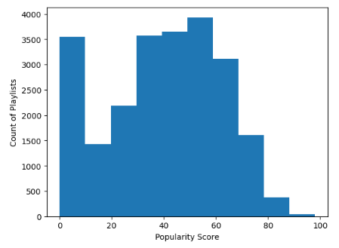
Data Distribution for popularity
NormaltestResult(statistic=1.2675660465547283, pvalue=0.5305808000563881)
The mean popularity of track names is 39.43
The median popularity of track names is 42.0
The popularity of track names is ModeResult(mode=0.0, count=1943)
The population variance using the NumPy module is 501.74
The population standard deviation using the NumPy module is 22.40
5

Slide 6
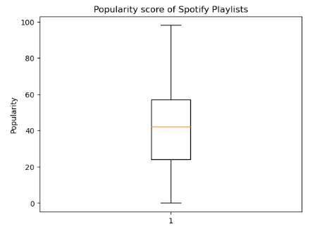
Search for popularity Outliers
Roughly 68% of the data is between 17.03 and 61.83
Roughly 95% of the data is between -5.37 and 84.23
Roughly 99.7% of the data is between -27.77 and 106.63
The lower quartile of popularity is: 24.0
The upper quartile of popularity is: 57.0
The interquartile range of popularity is: 33.0
Values below -25.5 could be outliers.
Values above 106.5 could be outliers.
Data does not include outliers based on Popularity Score
6

Slide 7
Question One - Genre
How does genre impact popularity?
What is the most popular genre for the entire dataset?
Have the popularity trends for genre changed over Decades?
What are the more recent trends of popularity for genre?

Slide 8
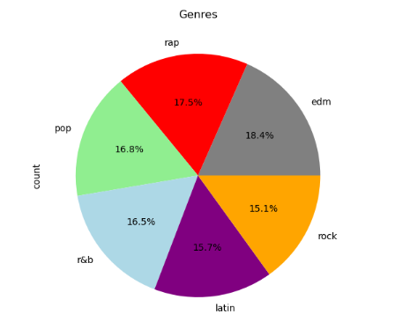
Genres represented in the data

Slide 9
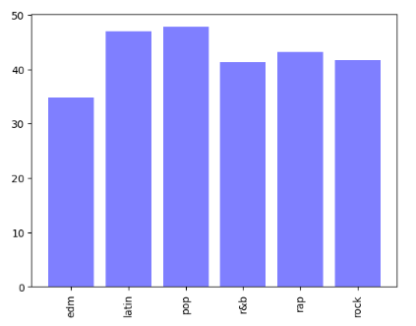
Popularity of Genre overall

Slide 10
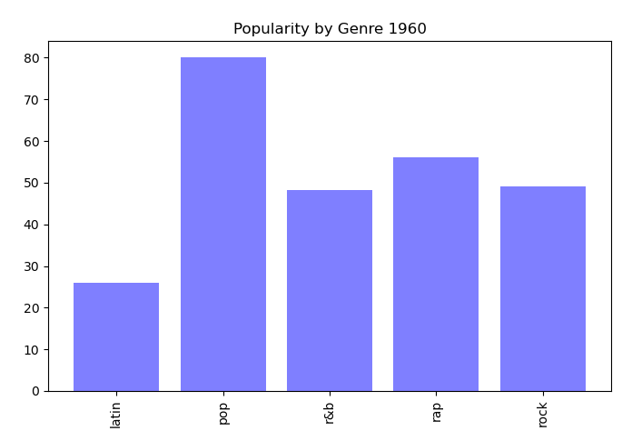
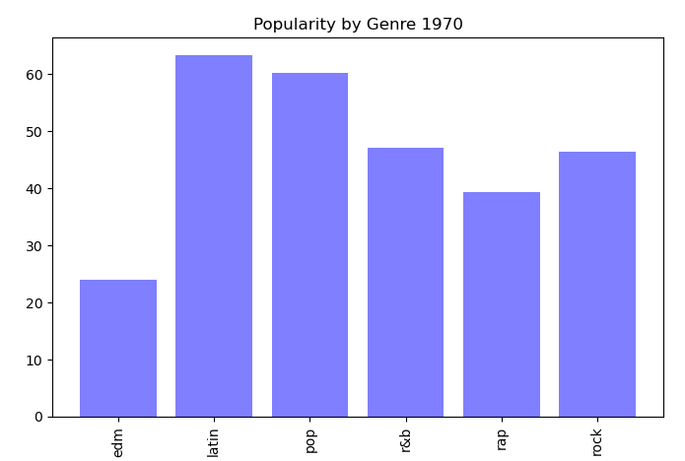
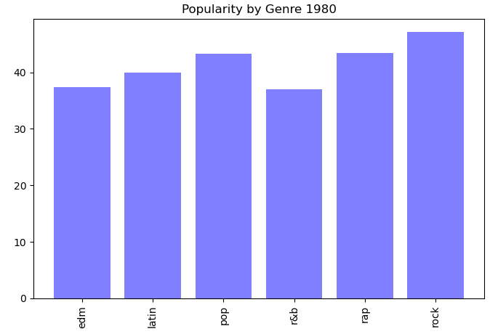
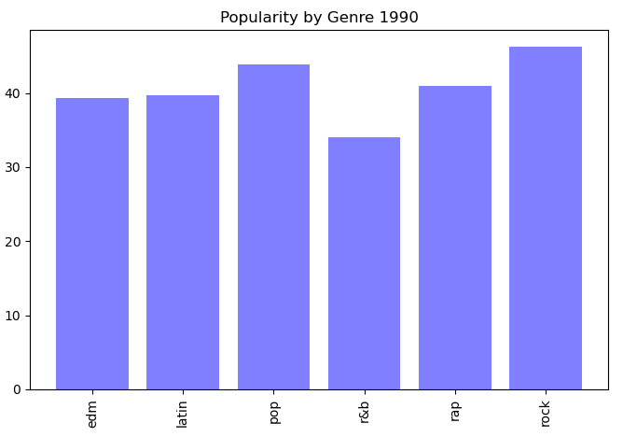
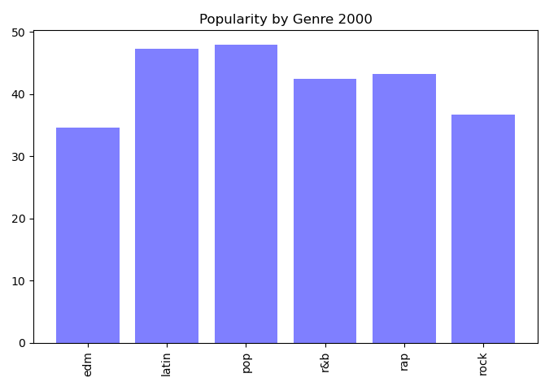
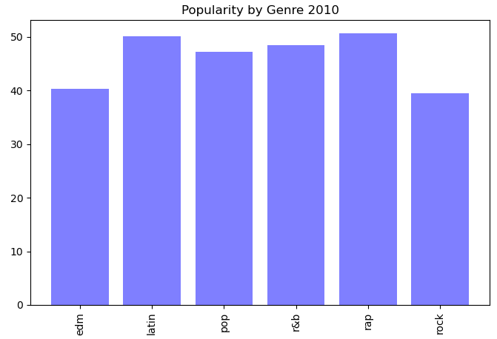
Popularity of Genre for each decade

Slide 11
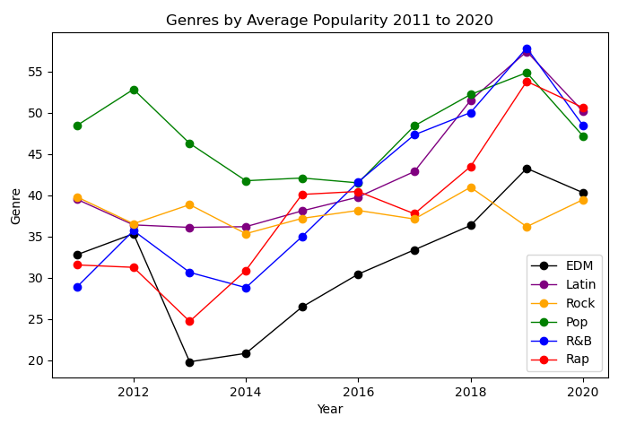
Popularity of Genre recent trend

Slide 12
Question Two - Key
Is there a correlation between the key of the song and popularity?
Key: The estimated overall key of the track. Integers map to pitches using standard Pitch Class notation . E.g. 0 = C, 1 = C♯/D♭, 2 = D, and so on. If no key was detected, the value is -1.

Slide 13
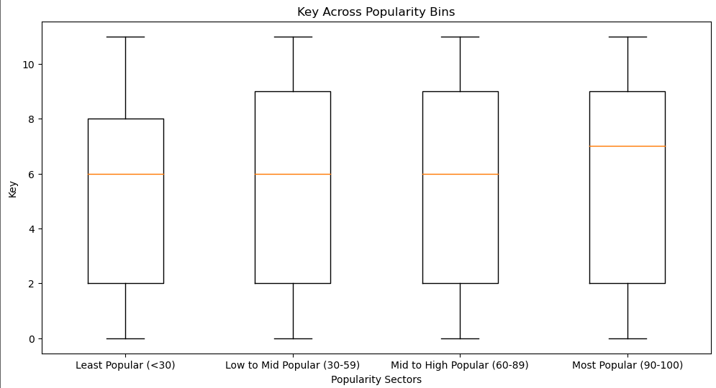
Key across popularity bins

Slide 14
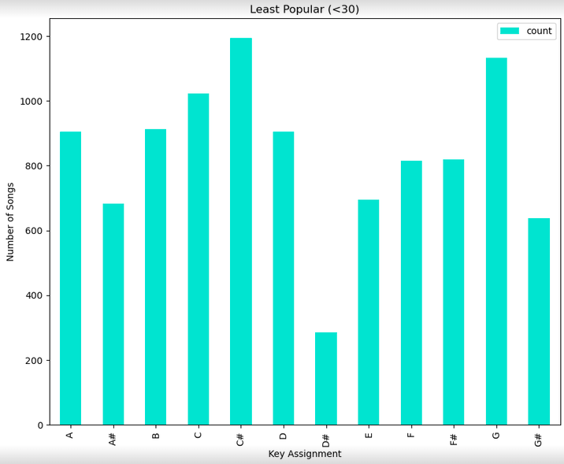
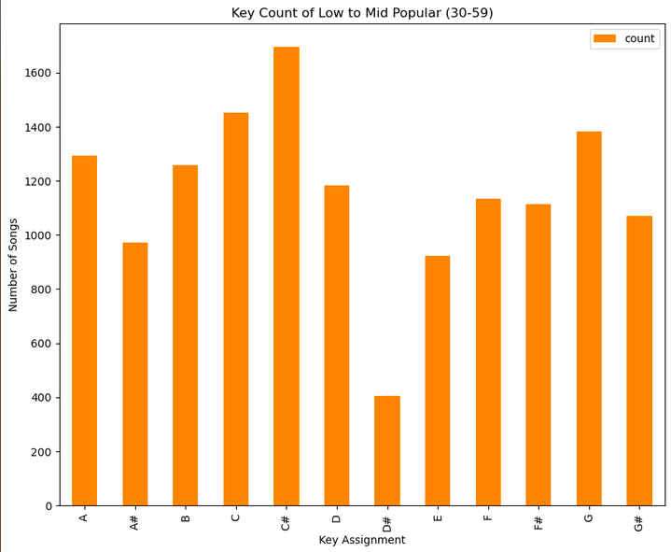
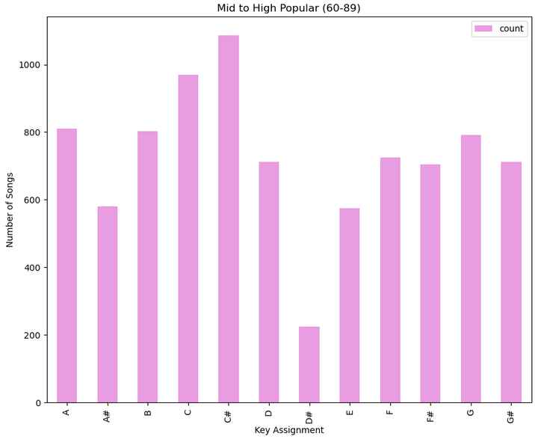
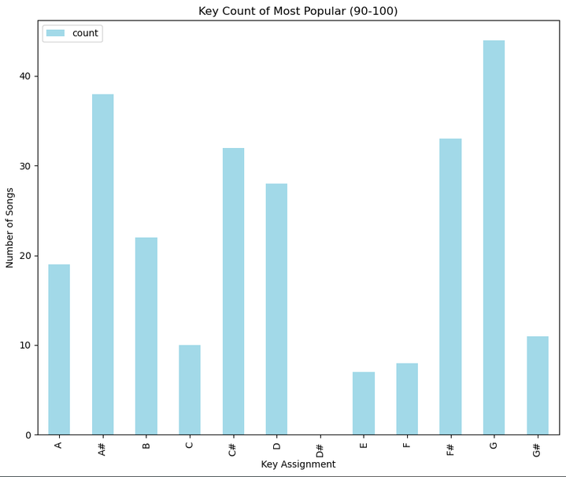
Keys by popularity

Slide 15
Question Three – Tempo
Is there a correlation between the tempo of the song and popularity?
Tempo: The overall estimated tempo of a track in beats per minute (BPM). In musical terminology, tempo is the speed or pace of a given piece and derives directly from the average beat duration.

Slide 16
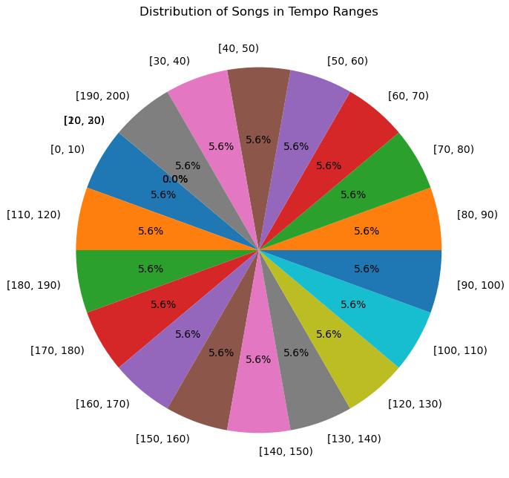
Distribution by Tempo ranges

Slide 17
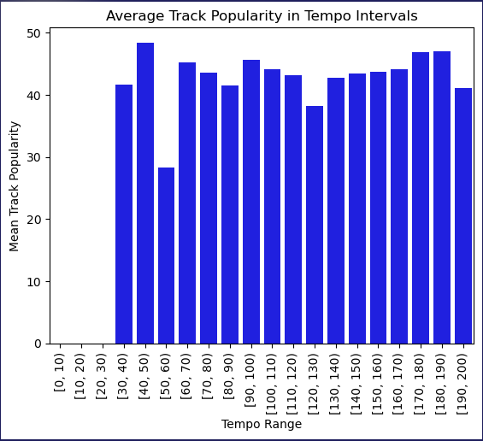
Average popularity by Tempo intervals

Slide 18
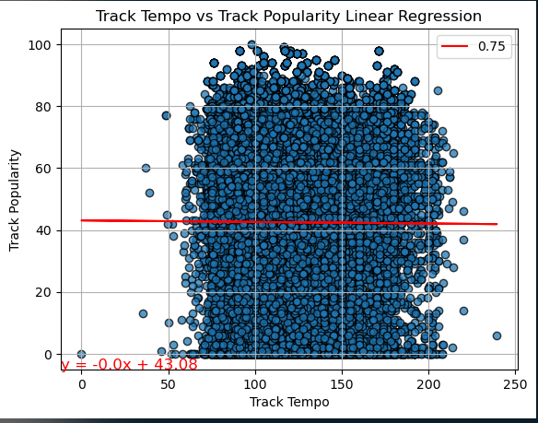
Track Tempo vs Popularity

Slide 19
Question four – Duration
is there a correlation between the duration of the song and popularity?
Duration: Duration of song in milliseconds.

Slide 20
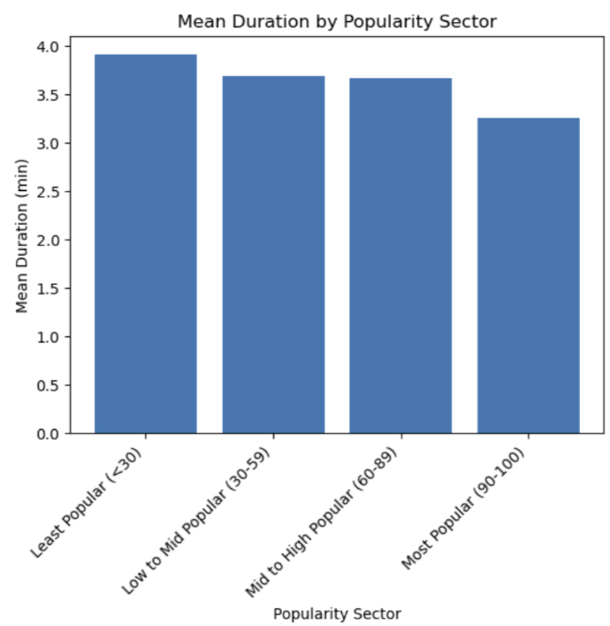
Average Duration by popularity bins

Slide 21
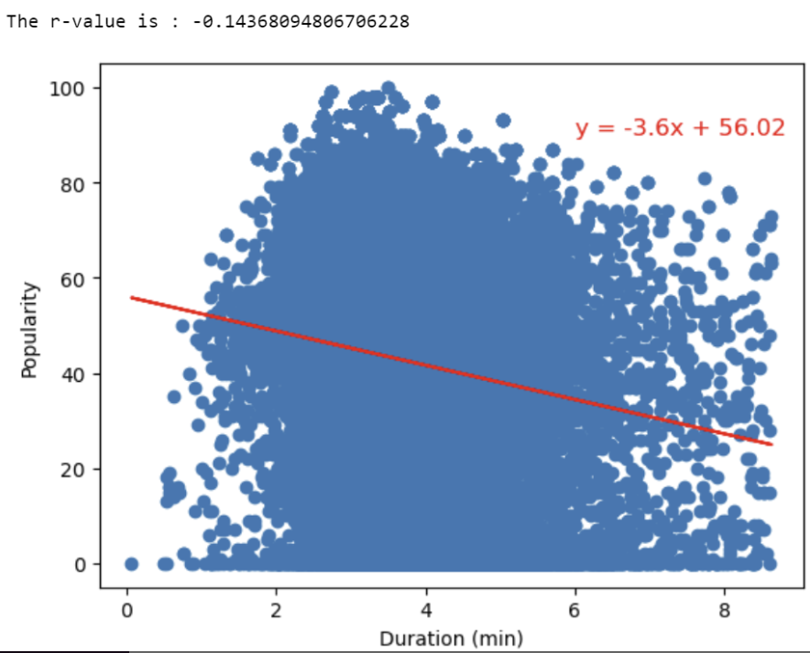
Song Duration vs popularity

Slide 22
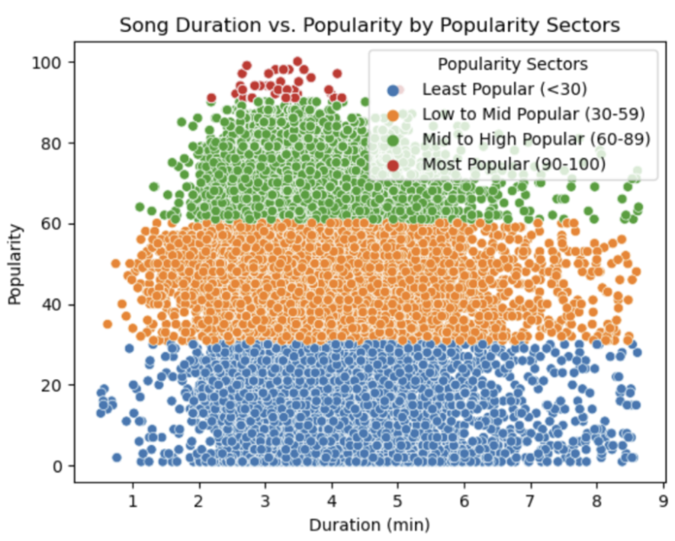
Song Duration vs popularity by bins

Slide 23
Question five – loudness
is there a correlation between the loudness of the song and popularity?
Loudness: The overall loudness of a track in decibels (dB). Loudness values are averaged across the entire track and are useful for comparing relative loudness of tracks. Loudness is the quality of a sound that is the primary psychological correlate of physical strength (amplitude). Values typical range between -60 and 0 db.

Slide 24
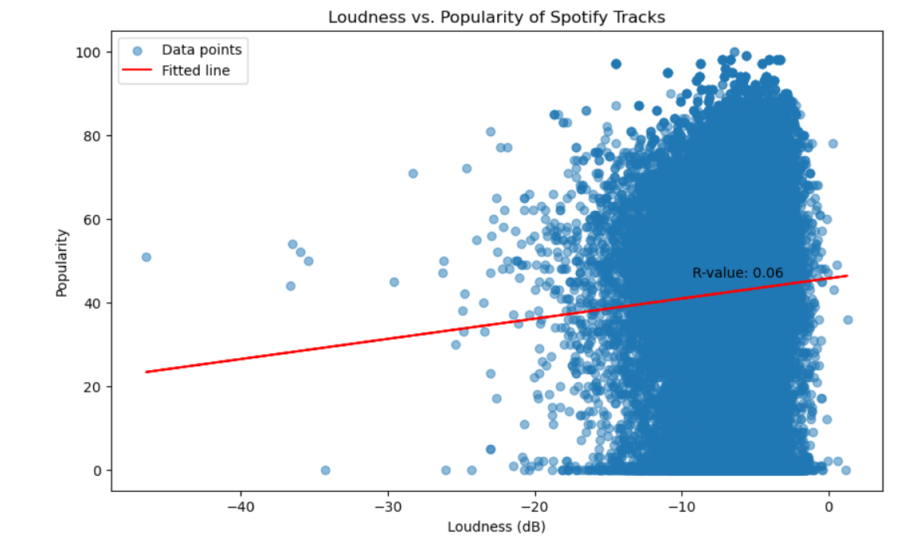
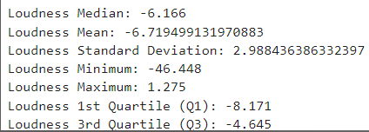
loudness vs popularity

Slide 25
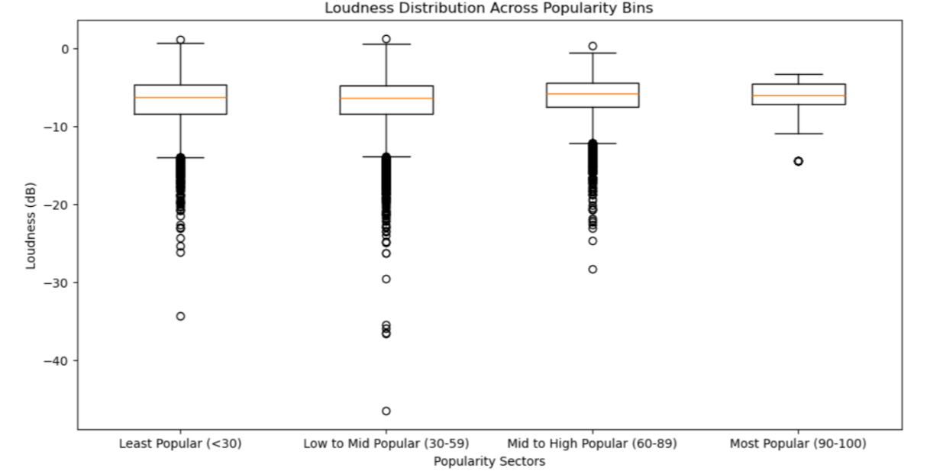
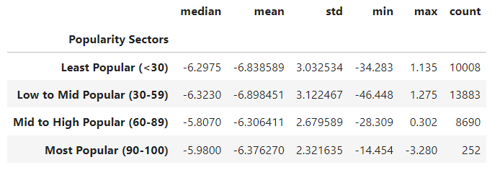
loudness Distribution by popularity bins

Slide 26
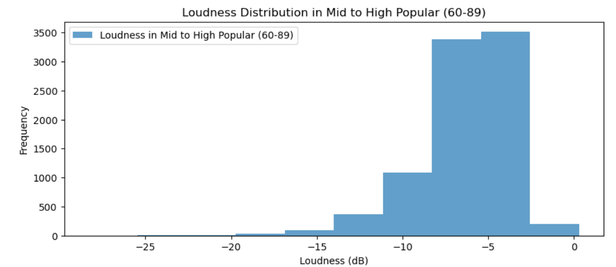
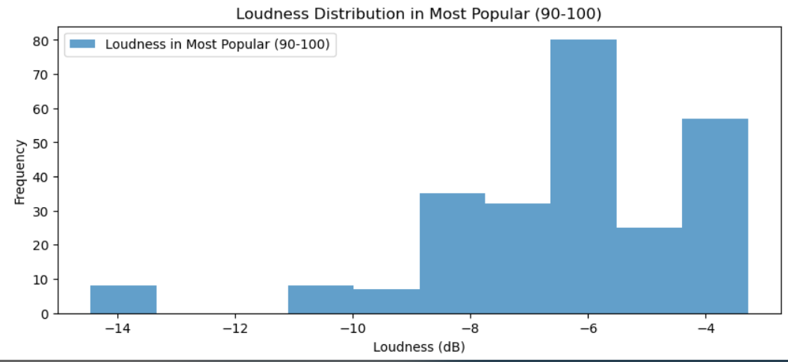
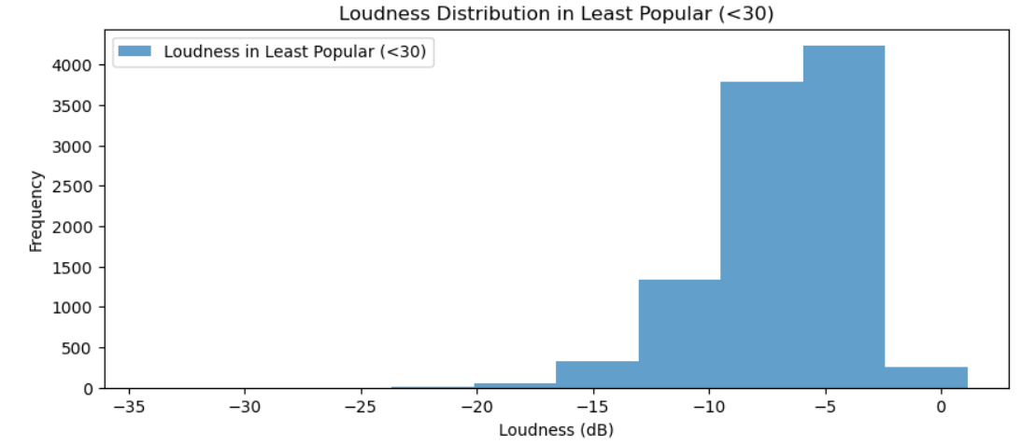
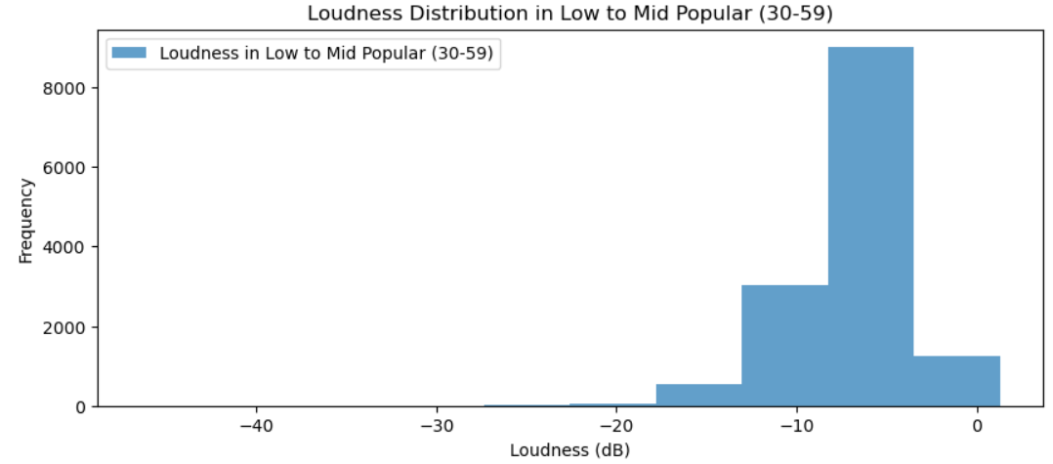
loudness Distribution by popularity bins

Slide 27
conclusion
GENRE: THERE WAS A WEAK CORRELATION AMONGST GENRES VS POPULARITY. HOWEVER, THIS CORRELATION CHANGES OVER TIME.
KEY: THERE WAS NO CORRELATION EVIDENT BY KEY VS POPULARITY. HOWEVER, A LARGER PORTION OF SONGS WERE WRITTEN IN C#.
TEMPO: NO CORRELATION FOUND
DURATION: LONGER SONGS ARE ASSOCIATED WITH LOWER POPULARITY.
LOUDNESS: NO CORRELATION FOUND

Slide 28

Questions?

